Slide 1
The Data Analysis Project for a Tennis Match Over a Year.

Slide 2
1. How many tennis players are included in the dataset? Unique Home Team Players 2447 Unique Away Team Players 2479 Total Unique Players (Combined) 2644

Slide 3
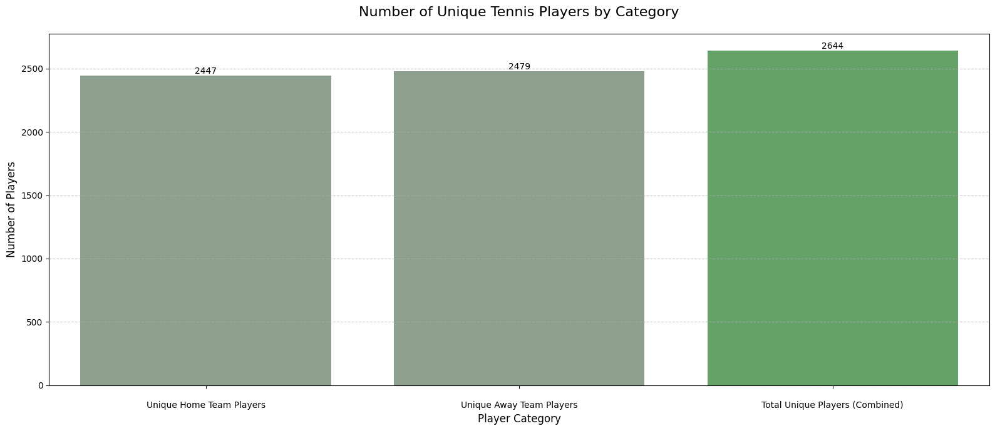
The total number of unique tennis players included in the dataset is 2644. The bar shows the overlap in player participation across home and away teams.

Slide 4
2. What is the average height of the players? Arithmetic Average of Height: 1.83

Slide 5
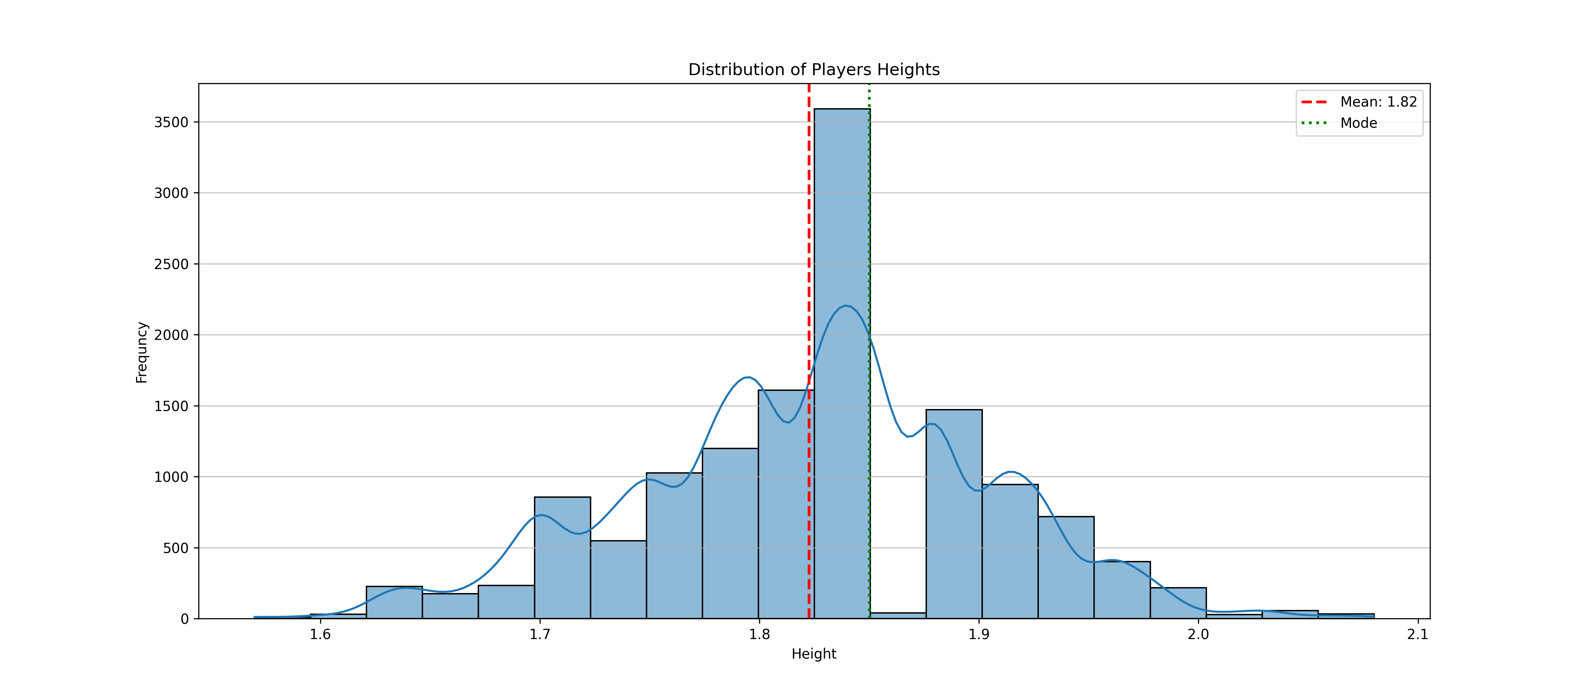
A histogram with a Kernel Density Estimate (KDE) plot overlaid, along with vertical lines indicating the mean and mode.

Slide 6
The large peak around 1.80m to 1.85m shows that most players have heights in this range.
Also there’s a smaller peak around 1.85m to 1.90m which shows a positive skewed distribution which can show different player populations
There’s two apparent peaks, one around 1.82m and another around 1.87m, which shows that players height doesn’t follow a normal distribution.

Slide 7
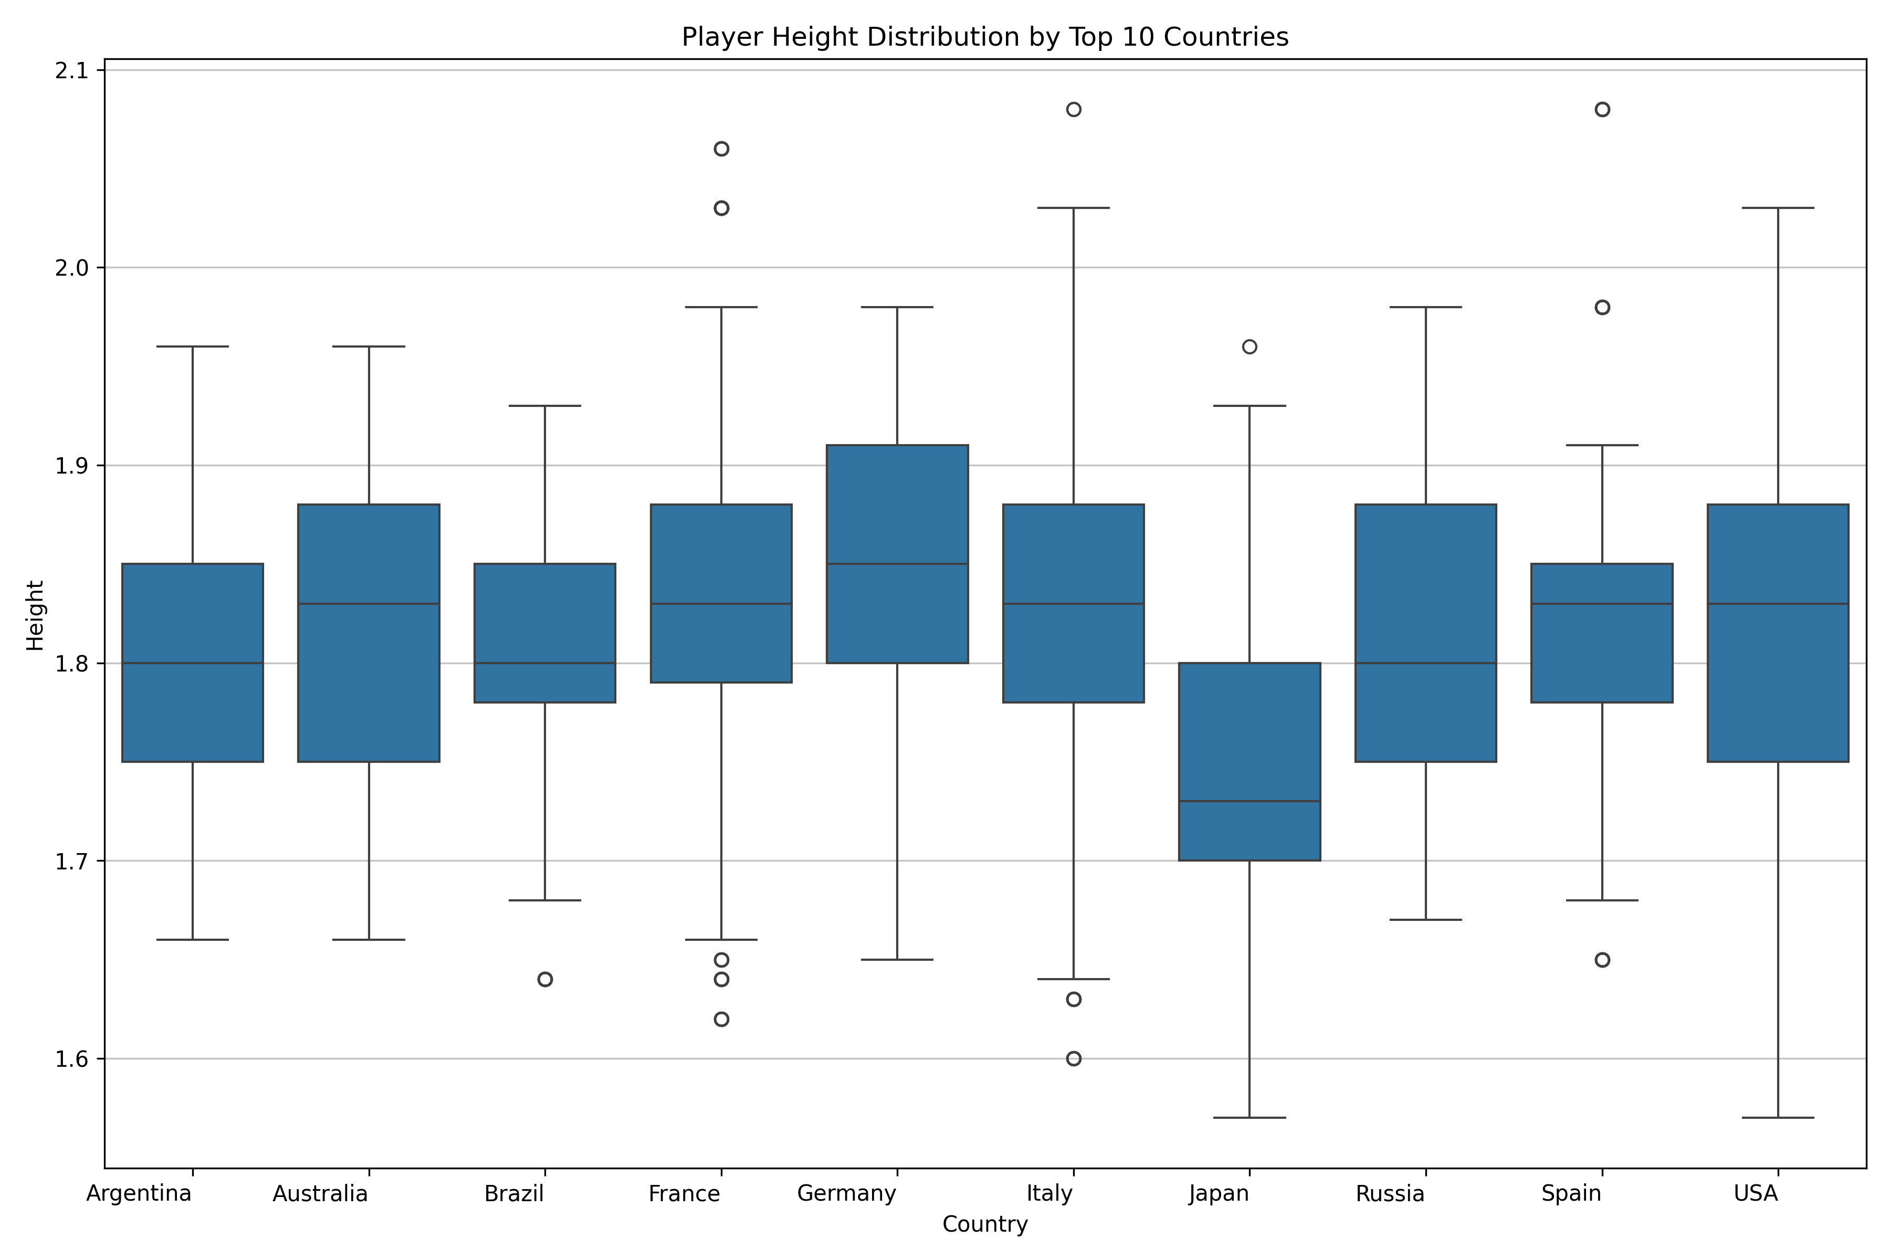
Germany appears to have some of the tallest players overall, with its median and upper quartile being among the highest.

Slide 8
Bot Plot and Whisker Plot:
Most players across these countries fall within a height range of roughly 1.65 meters to 1.95 meters.
Most countries show a median height around 1.80 to 1.85, but Japan shows a lower median height (1.72), which shows that Japanese players on average are shorter.
Countries like Germany, Italy or Russia have a wider spread which shows more diverse heights among their players.
Argentina has outliers on the shorter side, while Germany, Italy, Russia, and the USA have very tall outliers, and France has outliers on both ends.

Slide 9
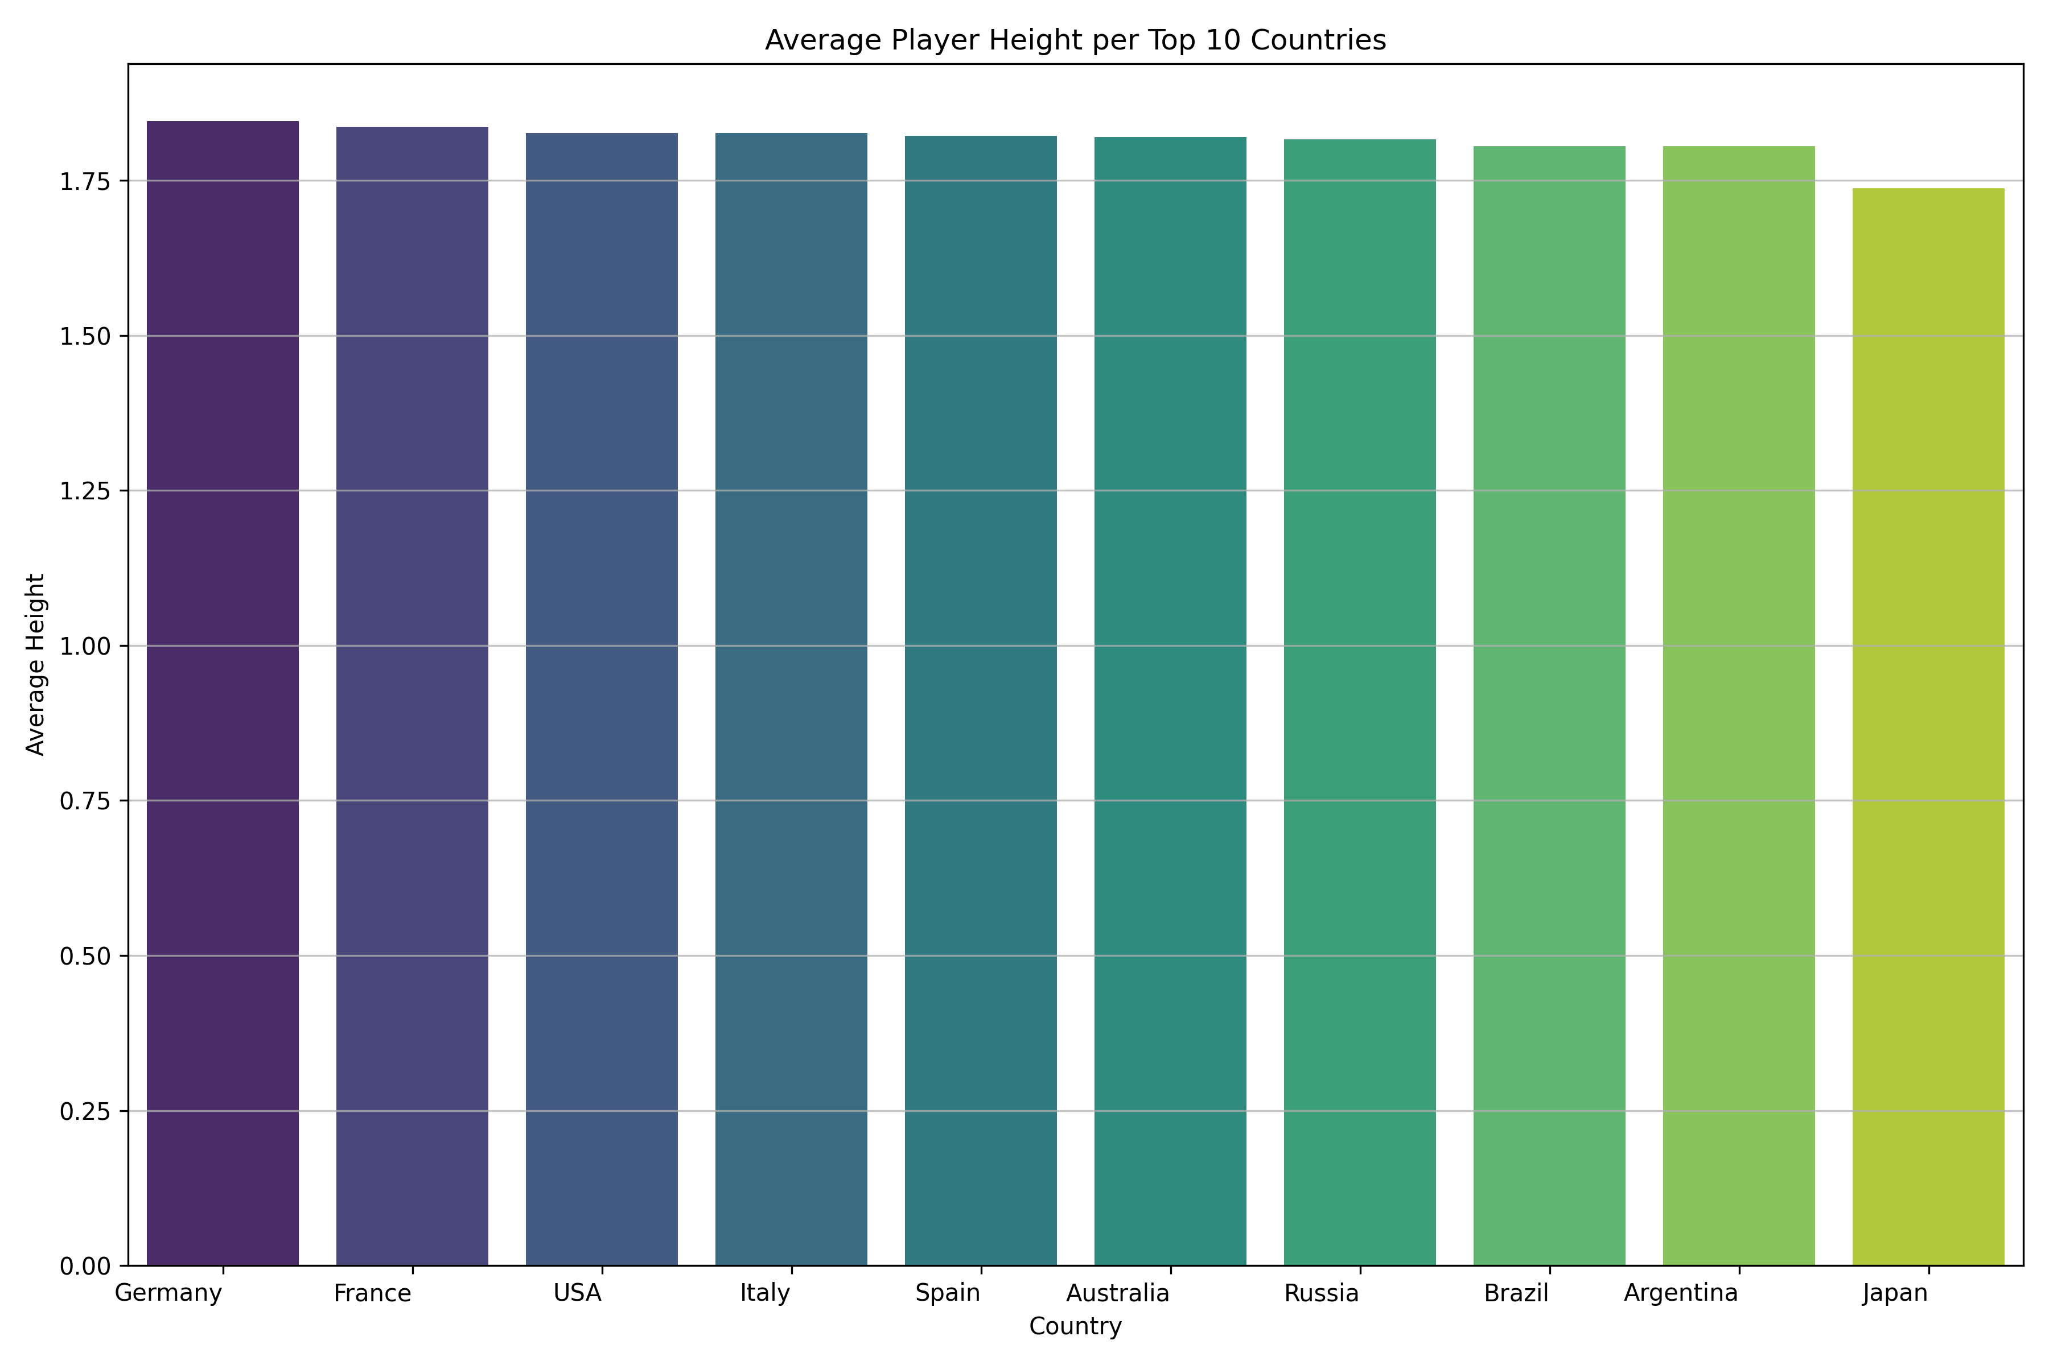

Slide 10
Germany and France have the highest average player heights.
Countries like USA, Italy, Spain, Australia, Russia, Brazil, and Argentina all show very similar average player heights.
Japan clearly has the lowest average player height among the top 10 countries.

Slide 11
3. Which player has the highest number of wins? Player with the most wins: 'Popko, Dmitry' with 29 wins.

Slide 12
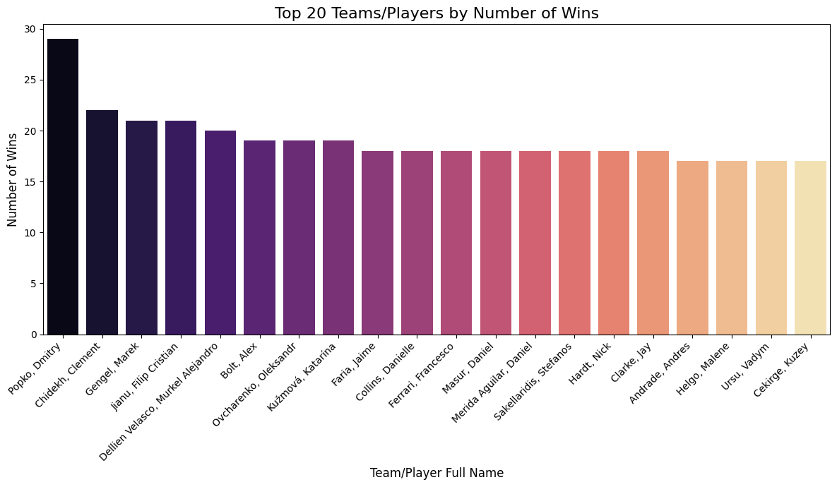

Slide 13
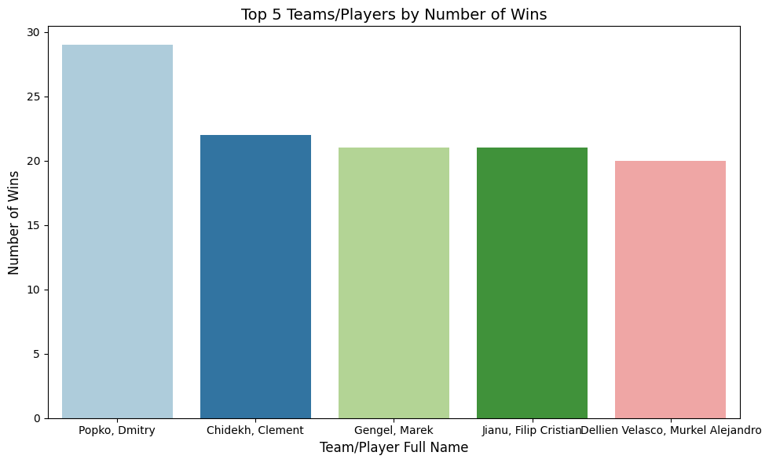

Slide 14
The charts collectively reveal a dataset where one player (Popko, Dmitry) has a clear lead in terms of wins, followed by a strong second-place player (Chidekh, Clement).

Slide 15
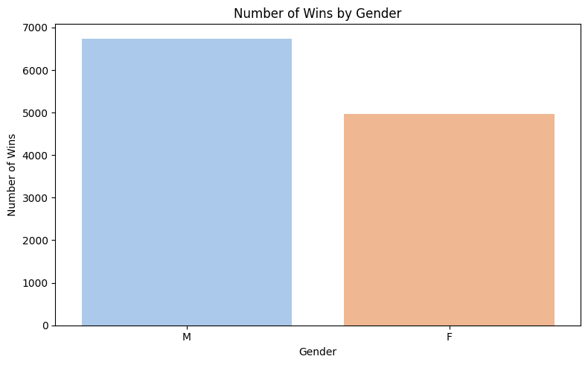

Slide 16
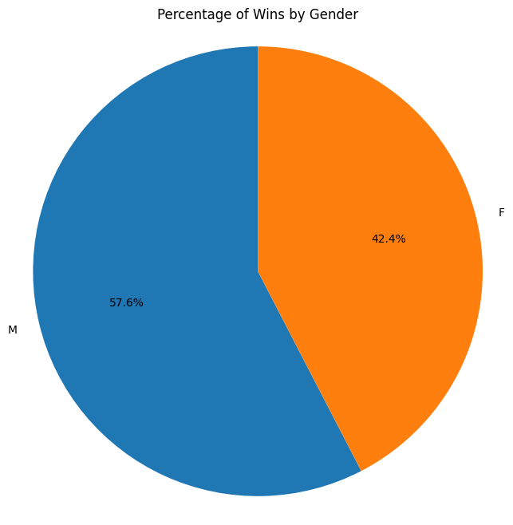

Slide 17
The bar chat shows that male players have a higher number of wins around 6700_6800 compared to female players around 4900_5000.
Also the pie chart represents male accounts 57.6% of all wins and female for 42.4%.

Slide 18
4. What is the longest match recorded in terms of duration? The longest match recorded is Match ID: 12063611 Total Duration: 336790.0

Slide 19
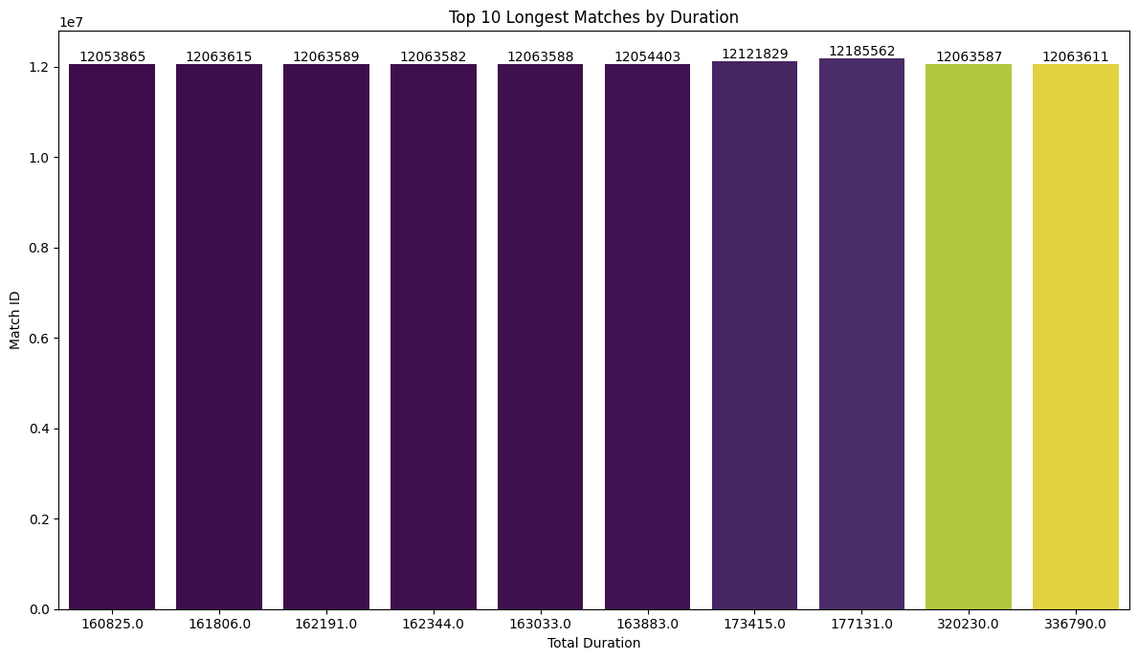

Slide 20
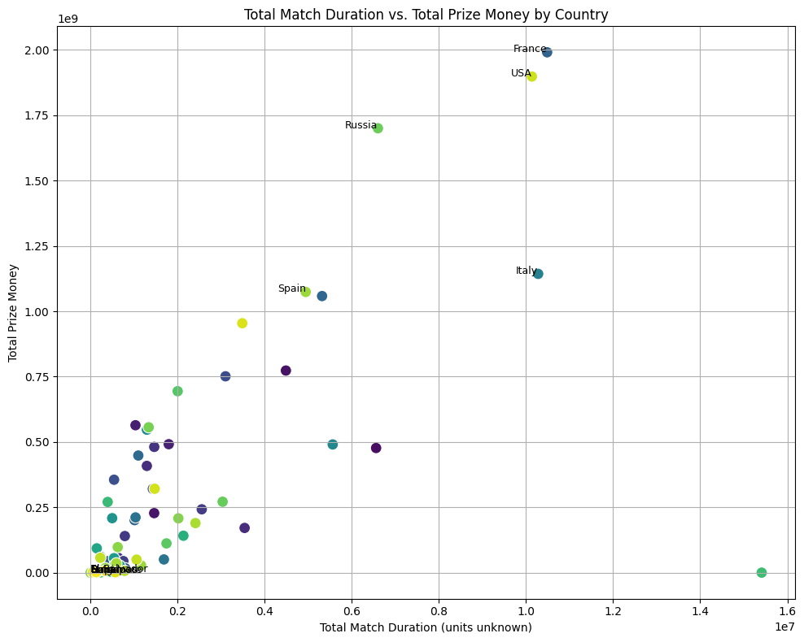

Slide 21
A Scatter Plot:
France, USA, Russia, Spain, Italy: These countries are prominent, with France and USA leading both in total match duration (around 1.0-1.1 * 10^7) and particularly in total prize money (close to 2.0 * 10^9).
Russia also shows high total match duration (around 0.6 * 10^7) and substantial prize money (around 1.7 * 10^9).
Spain and Italy are also high earners and duration accumulators, though slightly less than the absolute top.
There appears to be a general positive correlation between total match duration and total prize money. Countries whose players collectively play for longer durations tend to accumulate more prize money. This is an expected relationship: more match play (especially at higher levels) typically leads to more prize money opportunities.
some countries might have similar durations but different prize money, or vice versa, indicating other factors at play (e.g., player skill, participation in high-prize tournaments vs. lower-tier events, or a country simply having more players).
There are labels for "El Salvador" and "Ecuador" down in the lower-left cluster, indicating they have very low total match duration and total prize money in this dataset.

Slide 22
5. How many sets are typically played in a tennis match? The average number of sets played per match is: 2.28

Slide 23
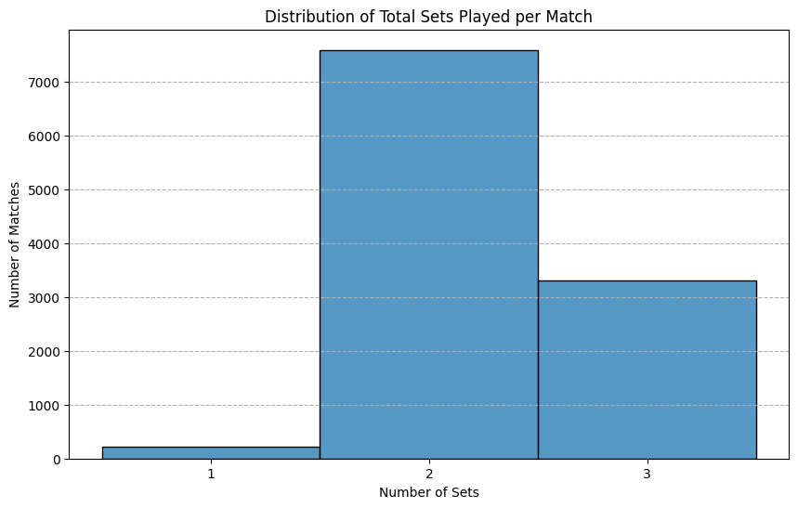

Slide 24
Most matches in the dataset (around 7500) are completed in 2 sets, indicating a "best of 3 sets" format where one player often wins straight sets. A notable number of matches (about 3300–3400) extend to a third set, reflecting competitive and balanced play. Very few 1-set matches appear, likely due to rare circumstances such as retirements or walkovers.

Slide 25
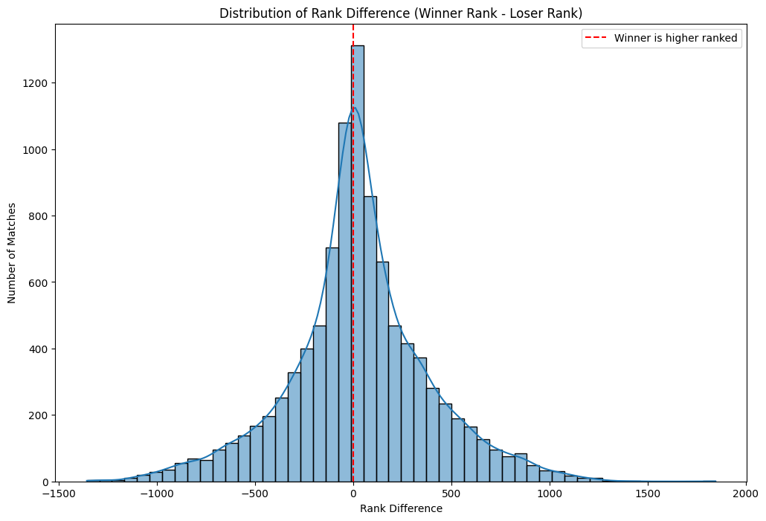
Percentage of matches won by the higher-ranked player: 31.78%

Slide 26
The most significant observation is the peak of the distribution in the negative rank difference range. This strongly suggests that in the majority of tennis matches in this dataset, the player with the better (lower) rank is the one who wins.
The most significant observation is the peak of the distribution in the negative rank difference range. This strongly suggests that in the majority of tennis matches in this dataset, the player with the better (lower) rank is the one who wins.

Slide 27
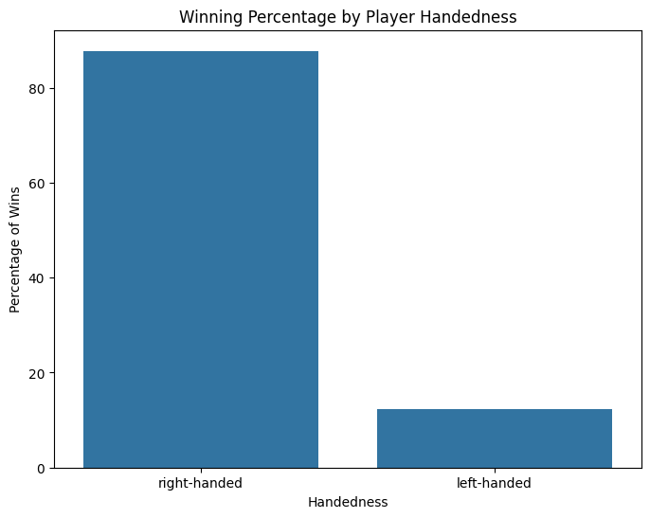
Winning percentage by handedness: winner_plays right-handed 87.738798 left-handed 12.261202

Slide 28
6. Which country has produced the most successful tennis players? France 992

Slide 29
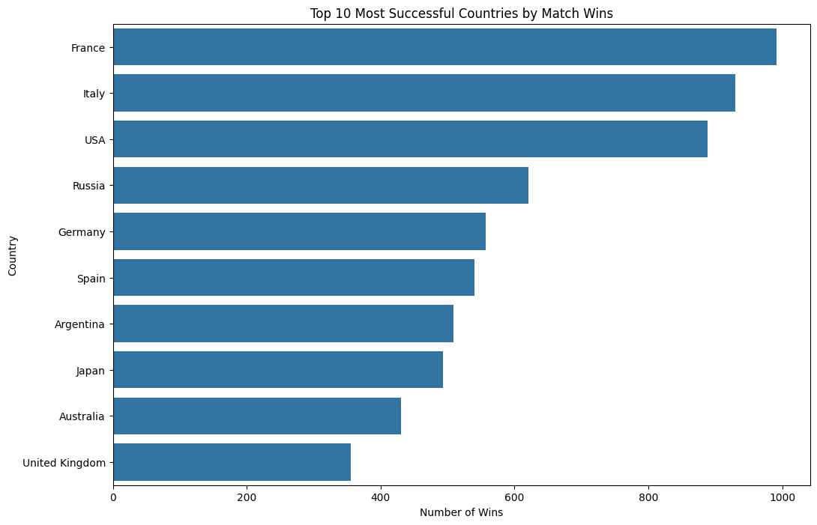

Slide 30
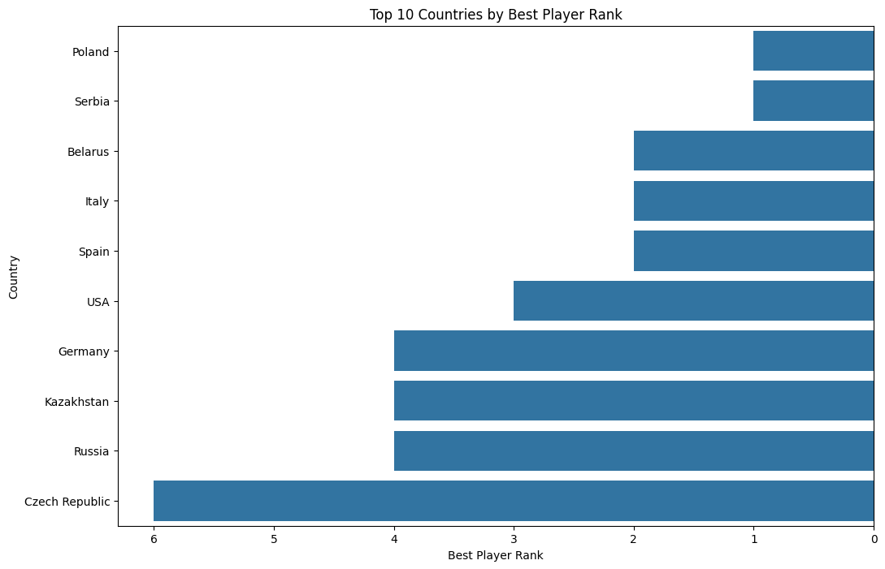

Slide 31
7. What is the average number of aces per match? Average number of aces per match: 4.58

Slide 32
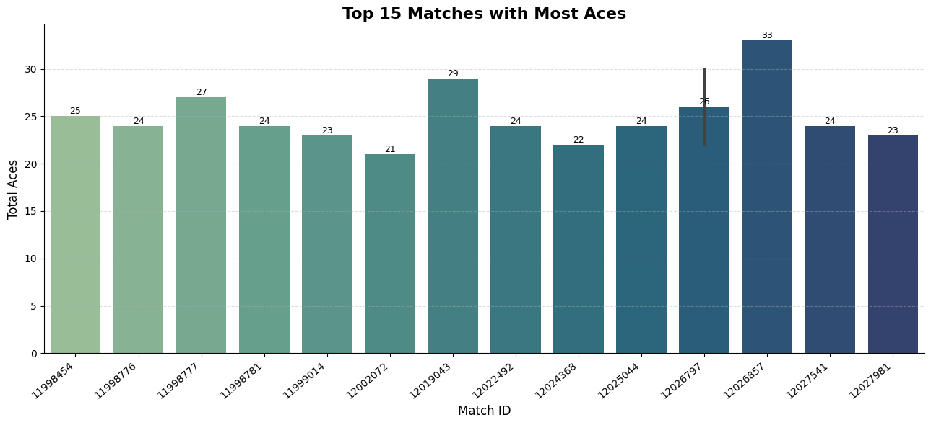

Slide 33
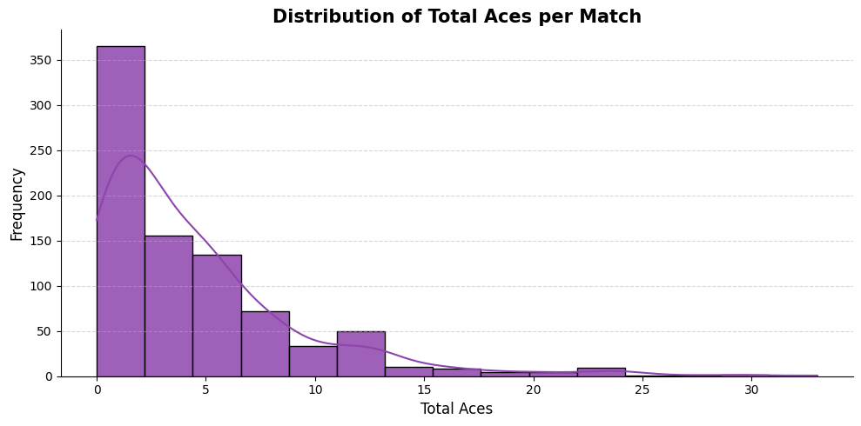

Slide 34
The most frequent outcome for aces in a match is a very low count, often 0-2 aces.
The distribution is highly right-skewed. This means that while most matches have a low number of aces, there's a long tail of matches that exceptionally have a higher number of aces. Matches with a high number of aces (e.g., 10 or more) are significantly less common, suggesting that matches with very dominant servers or very long, service-oriented contests are relatively rare.

Slide 35
8. Is there a difference in the number of double faults based on gender?
--- Descriptive Statistics for Double Faults by Gender ---
count mean std min 25% 50% 75% max
gender
F 30950.0 2.107981 2.249022 0.0 0.0 2.0 3.0 28.0
M 40166.0 1.599064 1.801070 0.0 0.0 1.0 2.0 21.0
--- Independent Two-Sample T-Test ---
T-statistic: -32.5674
P-value: 0.0000T
he difference in the mean number of double faults between genders is statistically significant.

Slide 36
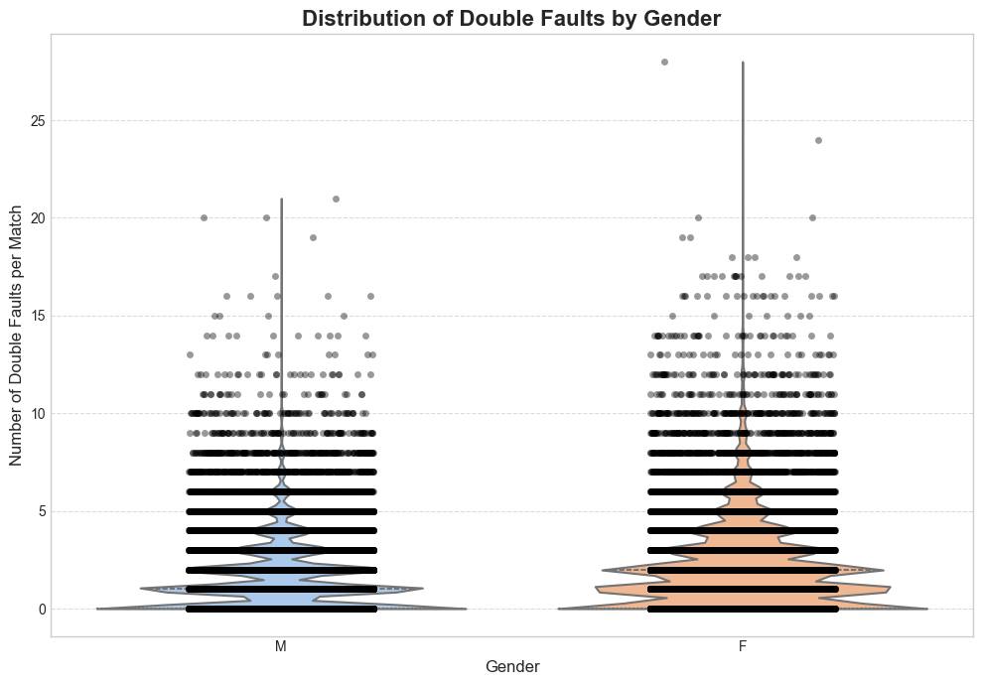

Slide 37
There are more data points for male players than for female players in this dataset.
The mean for females (2.11) is higher than for males (1.60), suggesting females commit more double faults on average.
Female double fault counts (2.25) are more varied or dispersed than male counts (1.80).
The median number of double faults for females is 2, while for males it is 1. This reinforces the idea that females tend to have more double faults per match.
75% of female matches had 3 or fewer double faults, while 75% of male matches had 2 or fewer. Again, this shows female matches tending to have higher double fault counts.
Female players recorded a higher maximum number of double faults in a single match compared to male players.
The t-statistic measures the size of the difference between the two group means relative to the variation within the groups.
A large absolute value (like 32.5674) indicates a substantial difference between the means. The negative sign simply means that the mean of the first group (F, as typically listed) is higher than the second (M). If we had subtracted M from F, it would be positive.
The p-value tells you the probability of observing a difference as large as (or larger than) the one you found, assuming there is no actual difference between the population means (i.e., assuming the null hypothesis is true).
A p-value of 0.0000T (which likely means it's extremely small, perhaps less than 0.0001) is much smaller than the conventional significance level of 0.05 (or even 0.01).

Slide 38
This chart is a Violin Plot with individual data points (jittered scatter plot) overlaid. This combination is highly effective for visualizing distributions, central tendencies, and individual data points simultaneously for multiple categories.
The female violin is visibly shifted upwards compared to the male violin. The bulk of female double fault counts are around 2-3, while for males, it's around 0-1. This visually confirms that female players, on average, commit more double faults per match.
The female violin extends higher and is wider at larger double fault counts, indicating that female matches not only have a higher average but also exhibit more variability and reach higher maximum double fault counts more frequently.
The clear separation and distinct shapes of the two violins, combined with the visible difference in their central lines (medians), visually support the statistical finding from the T-test: the difference in double fault rates by gender is indeed present and not just random noise.

Slide 39
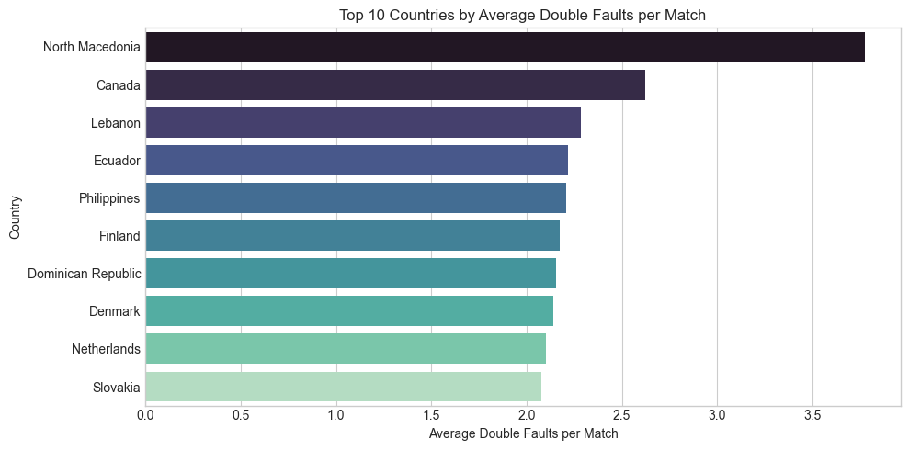

Slide 40
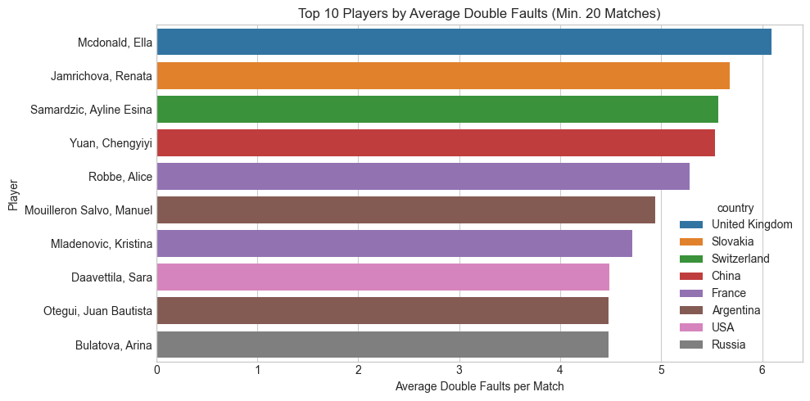

Slide 41
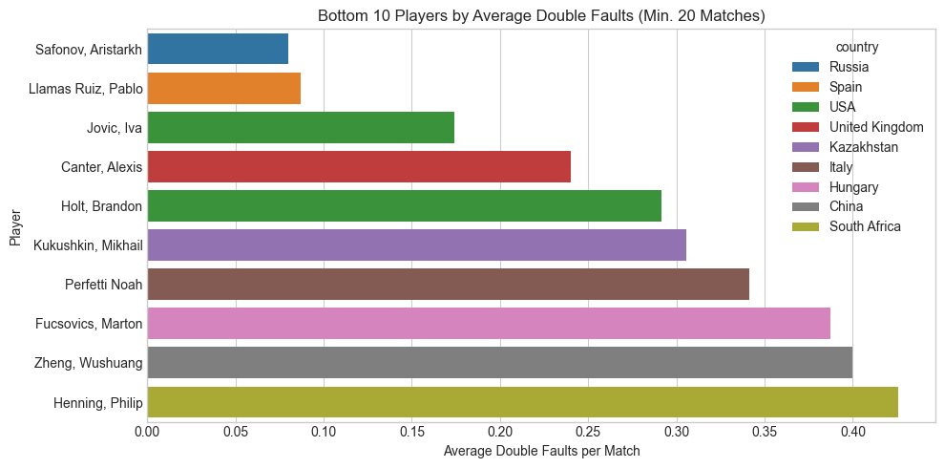

Slide 42
9. Which player has won the most tournaments in a single month?

Slide 43
10. Is there a correlation between a player's height and their ranking?

Slide 44
11. What is the average duration of matches?
Average match duration (in minutes) by gender: gender total_duration_min0
F 86.6639351 M 86.359736

Slide 45
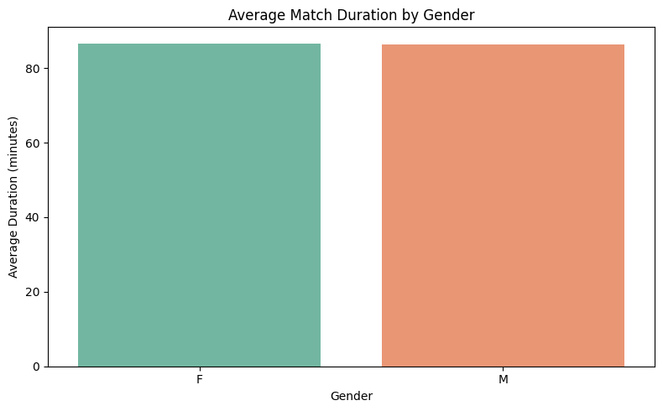

Slide 46
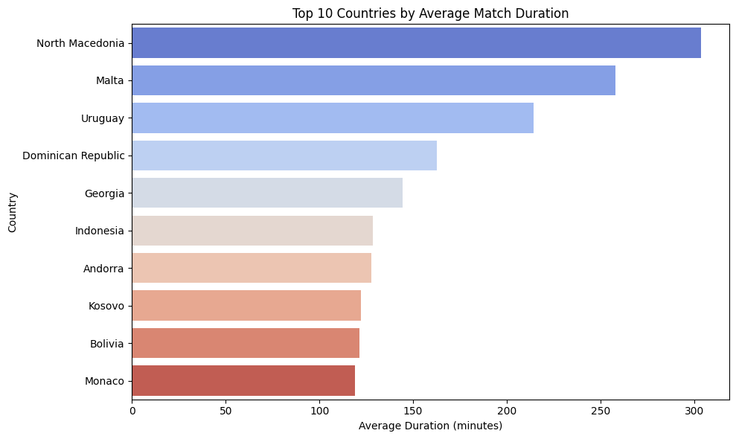

Slide 47
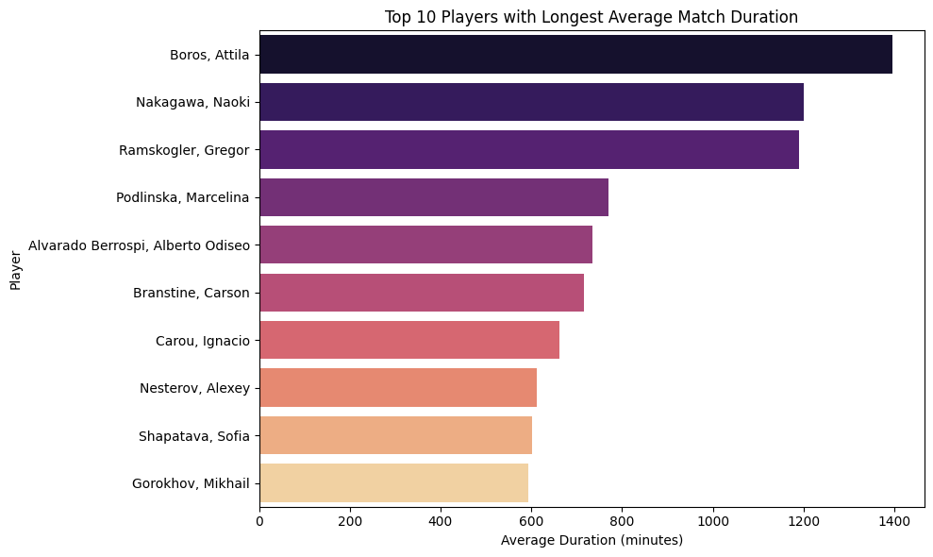

Slide 48
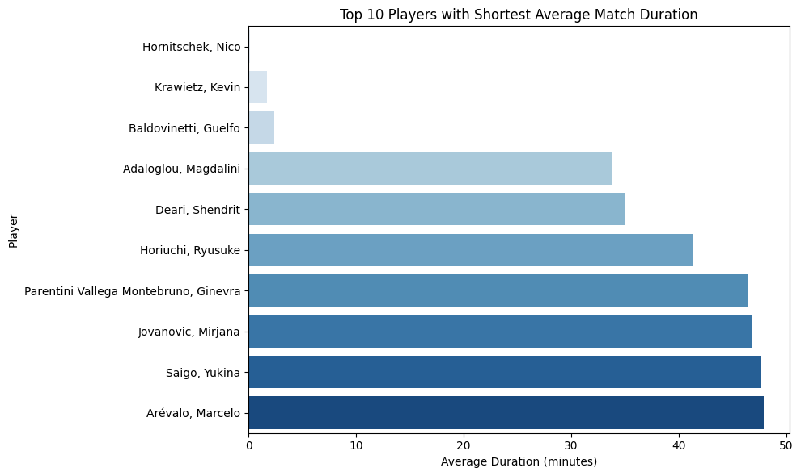

Slide 49
12. What is the average number of games per set in men's matches compared to women's matches?

Slide 50
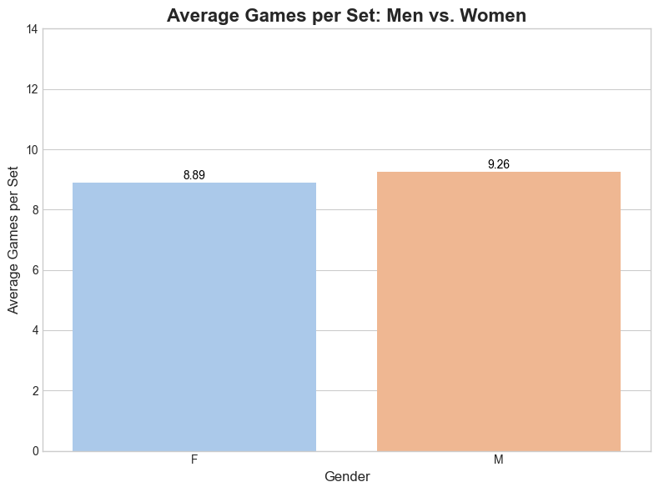

Slide 51
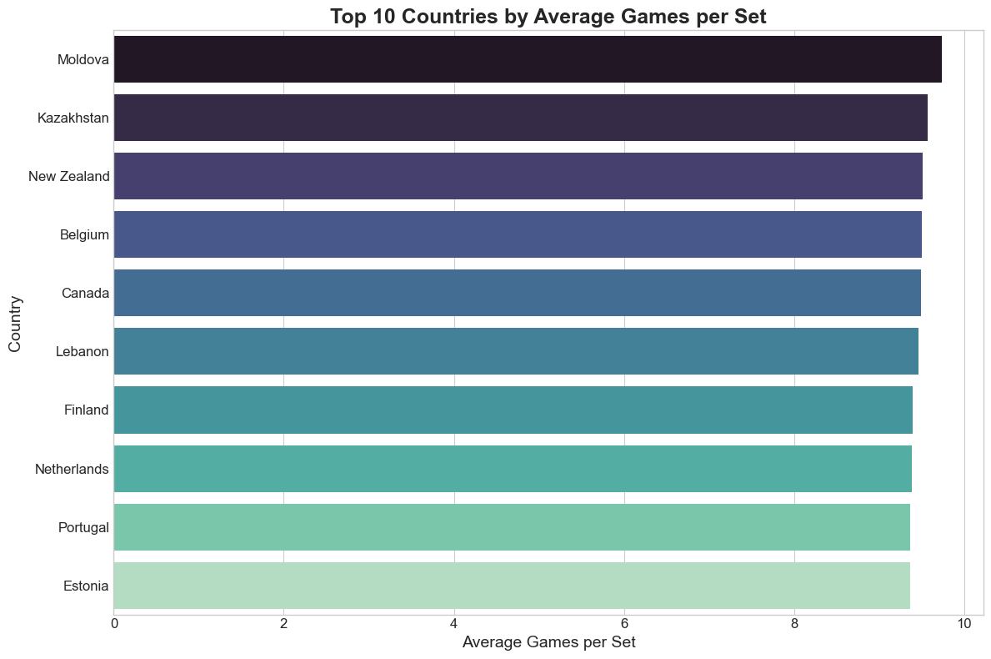

Slide 52
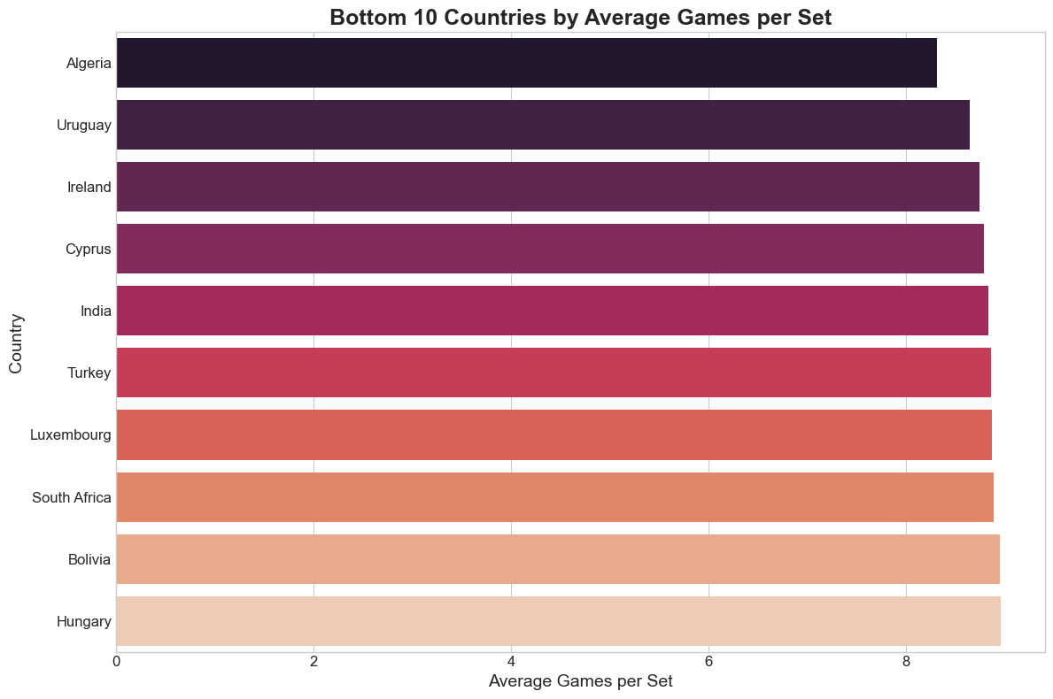

Slide 53
13. What is the distribution of left-handed versus right-handed players?

Slide 54
14. What is the most common type of surface used in tournaments?

Slide 55
15. How many distinct countries are represented in the dataset?

Slide 56
16. Which player has the highest winning percentage against top 10 ranked opponents?

Slide 57
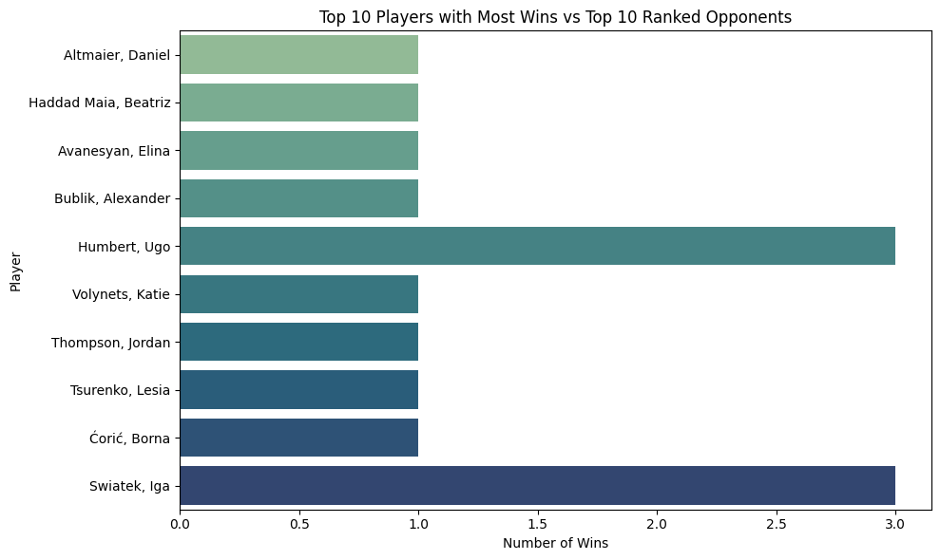

Slide 58
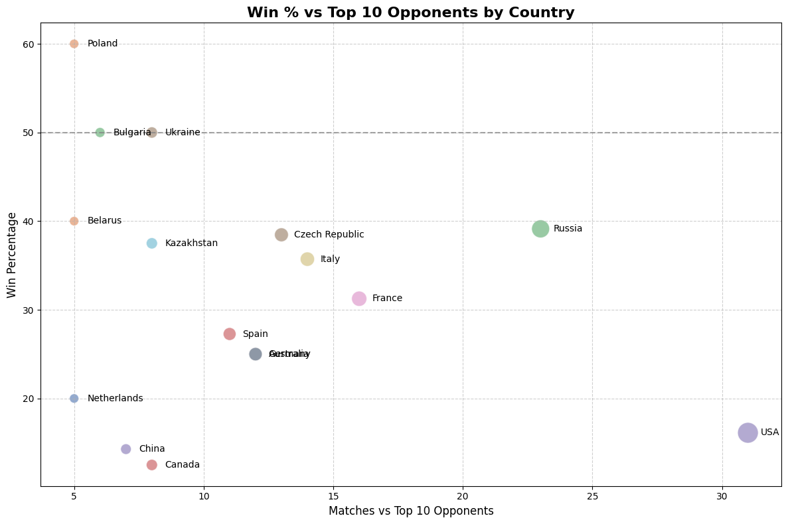

Slide 59
17. What is the average number of breaks of serve per match?

Slide 60
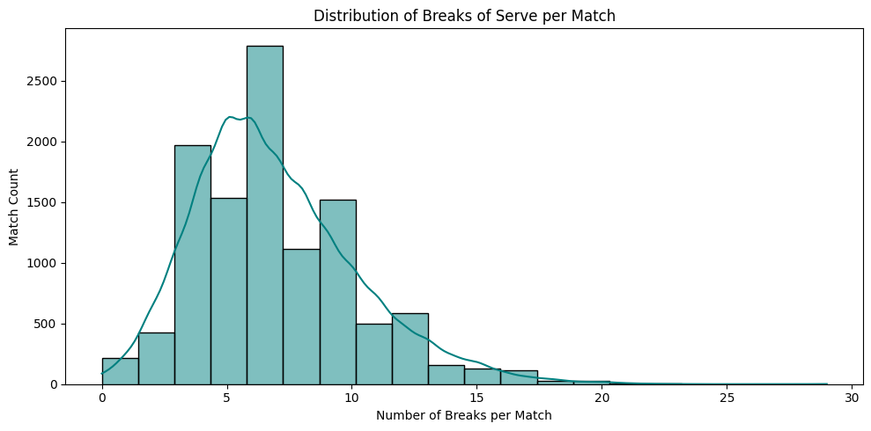

Slide 61
